Slide 1
Bicycle fleet management services

Slide 2
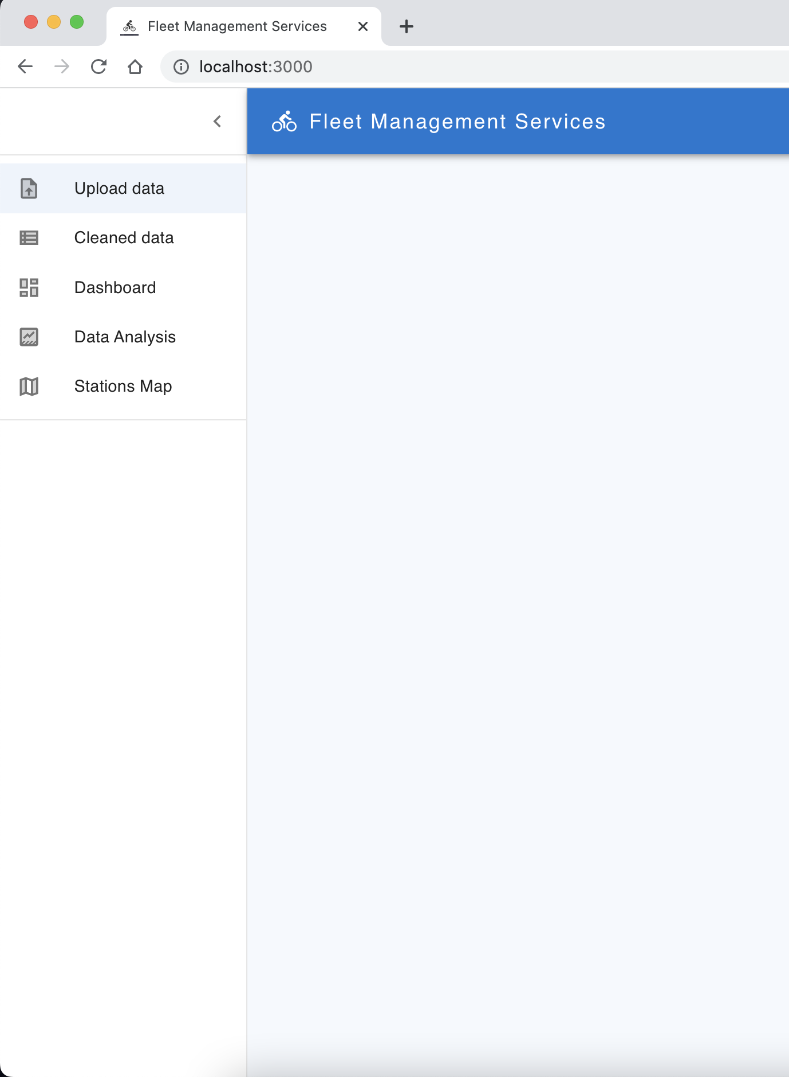
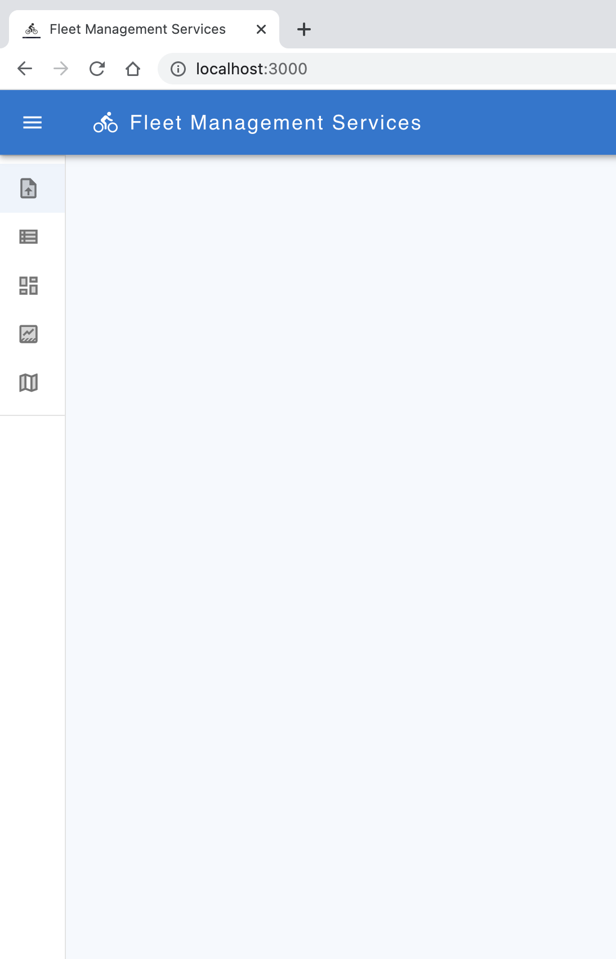
DRAWER VIEW OPEN & CLOSE

Slide 3
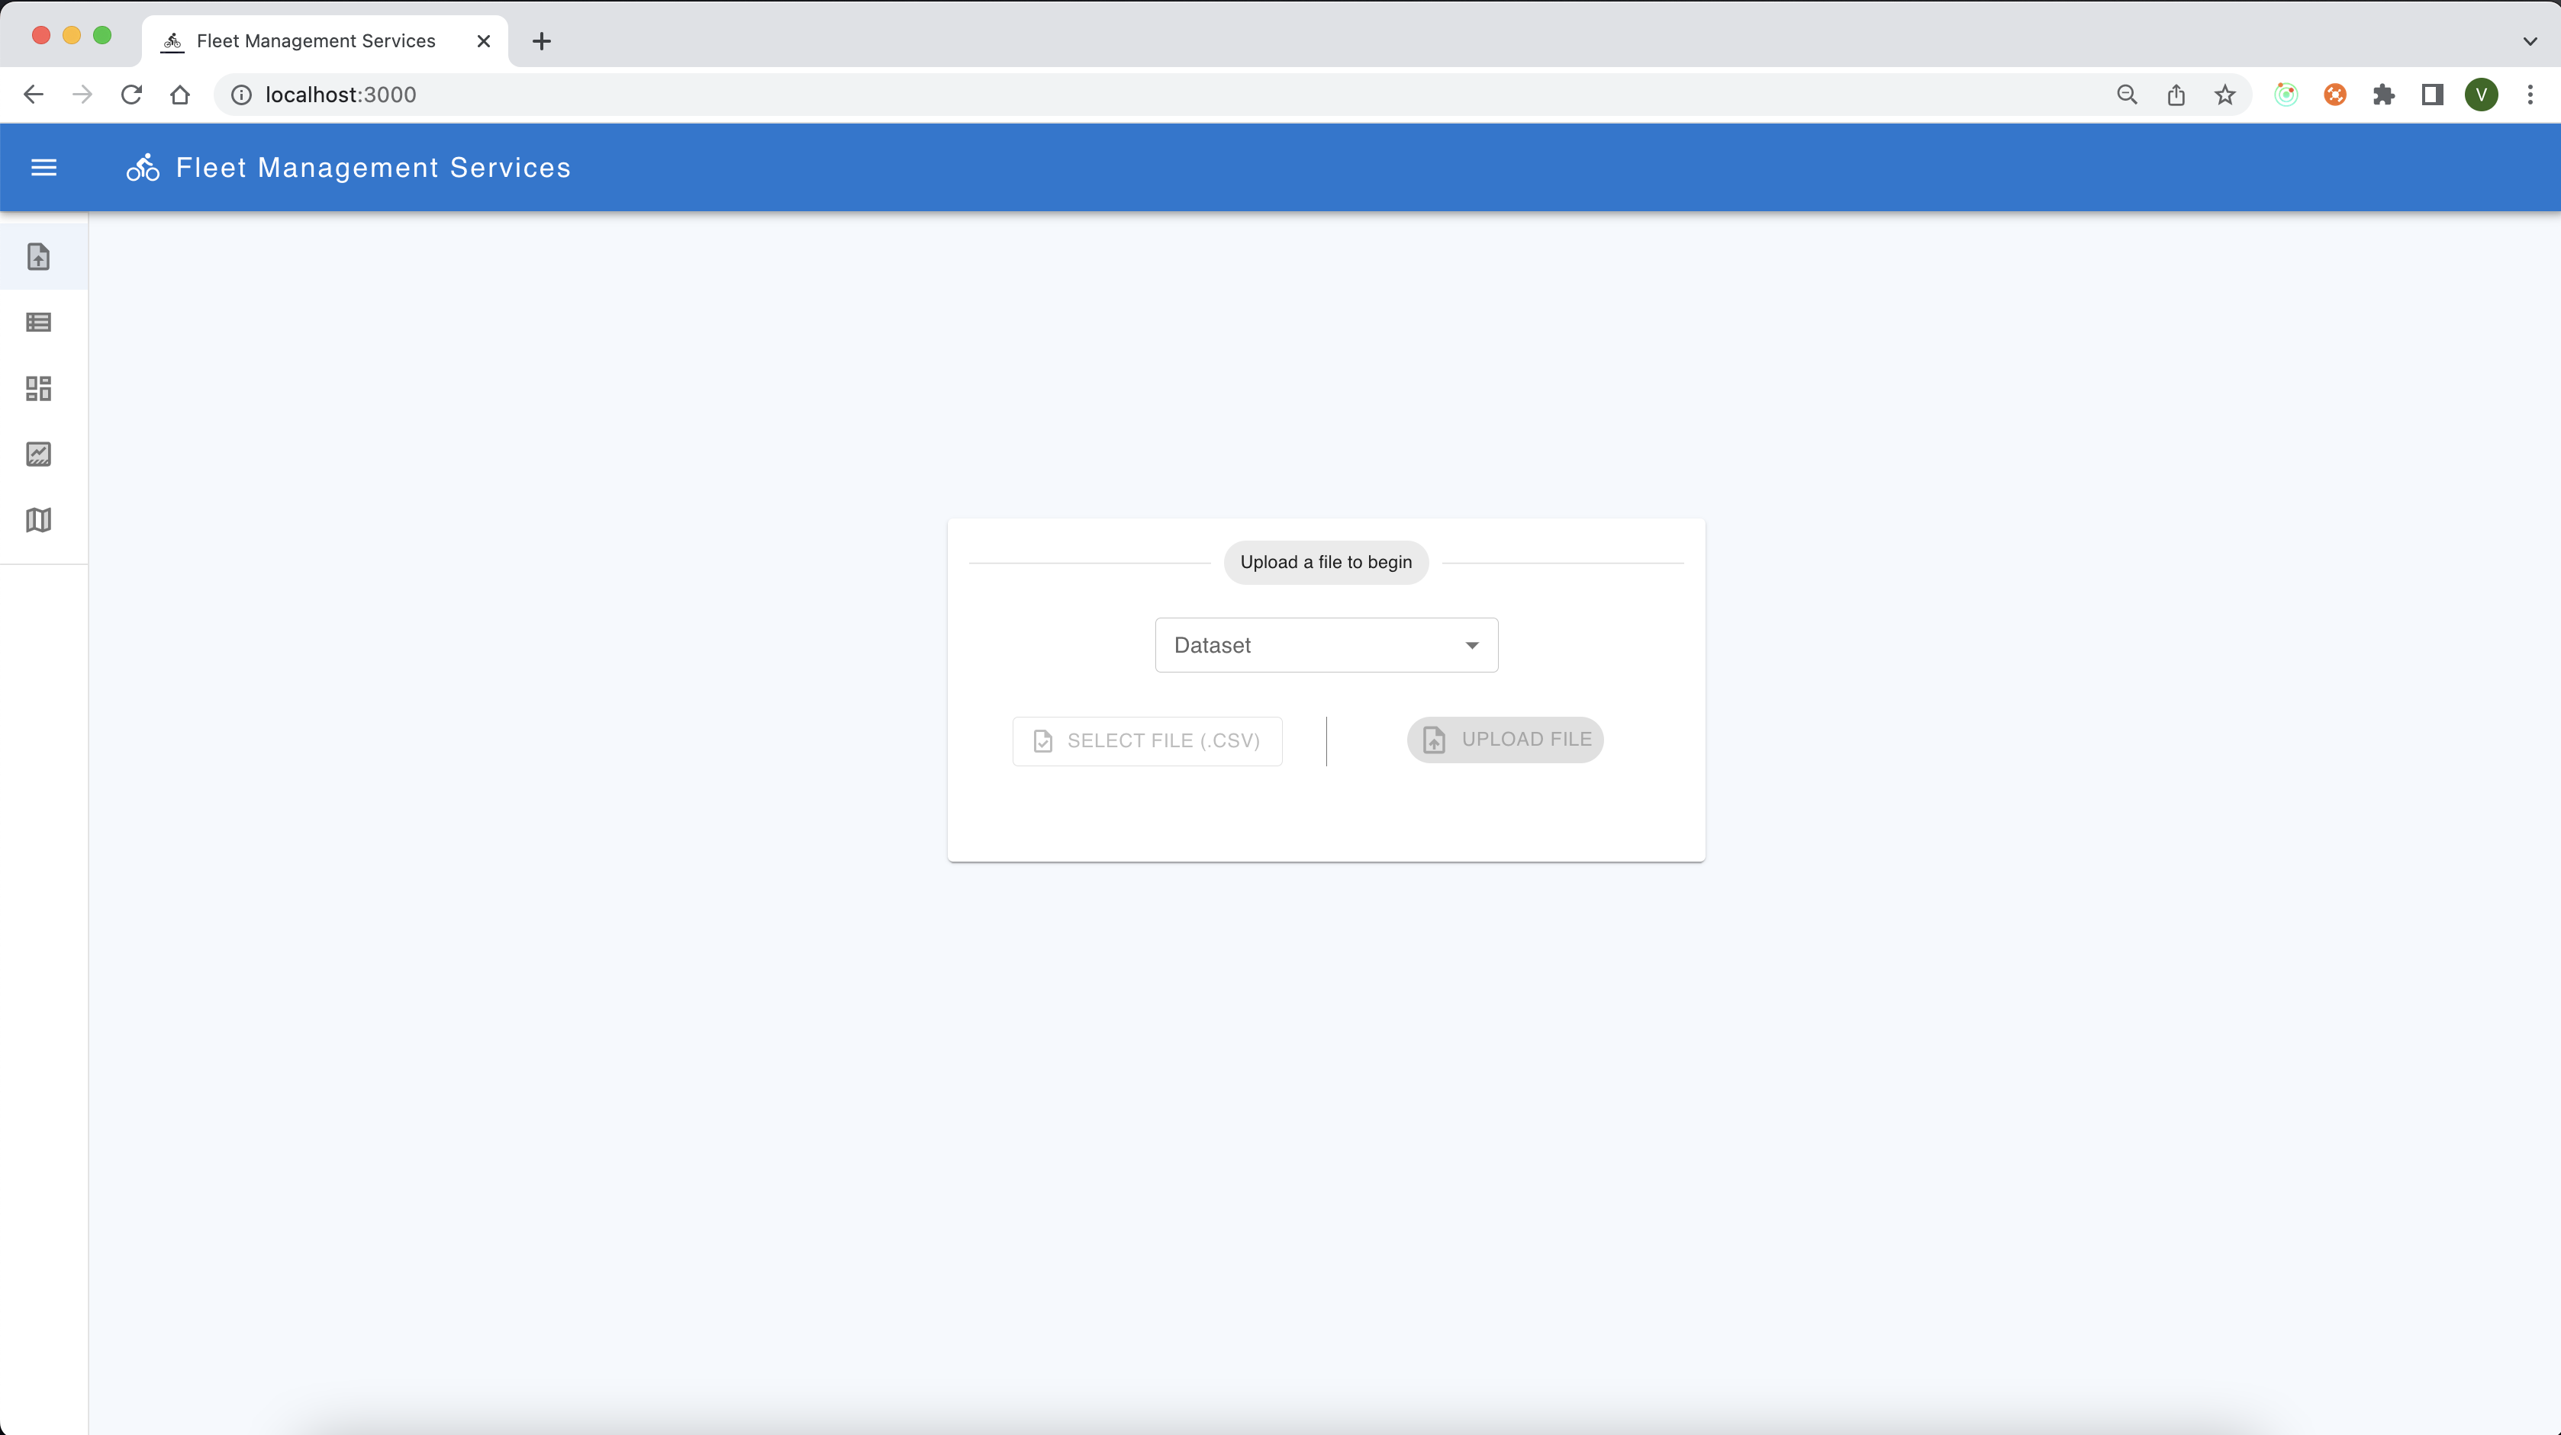
Upload File Screen 1/3

Slide 4
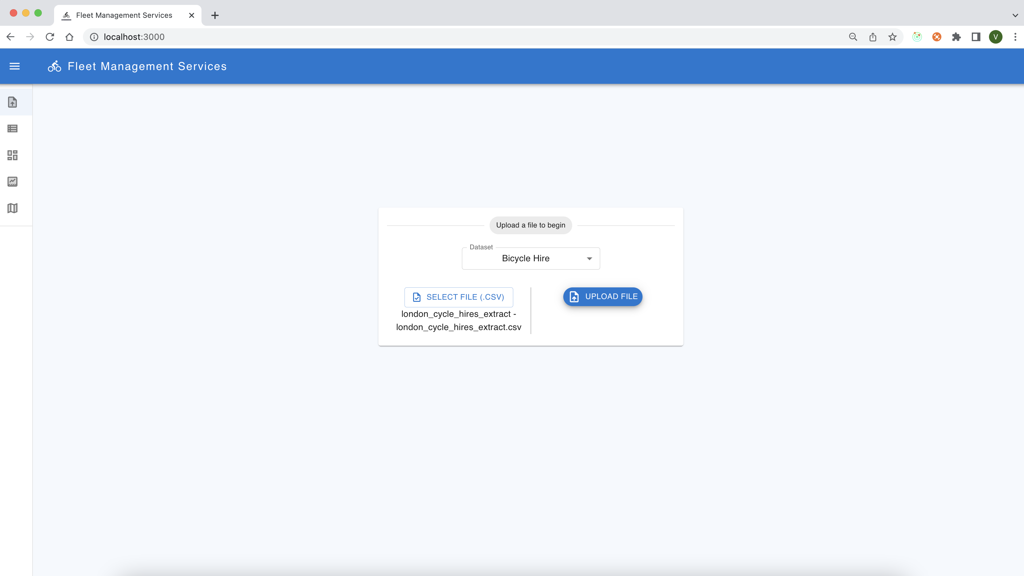
Upload File Screen 2/3

Slide 5
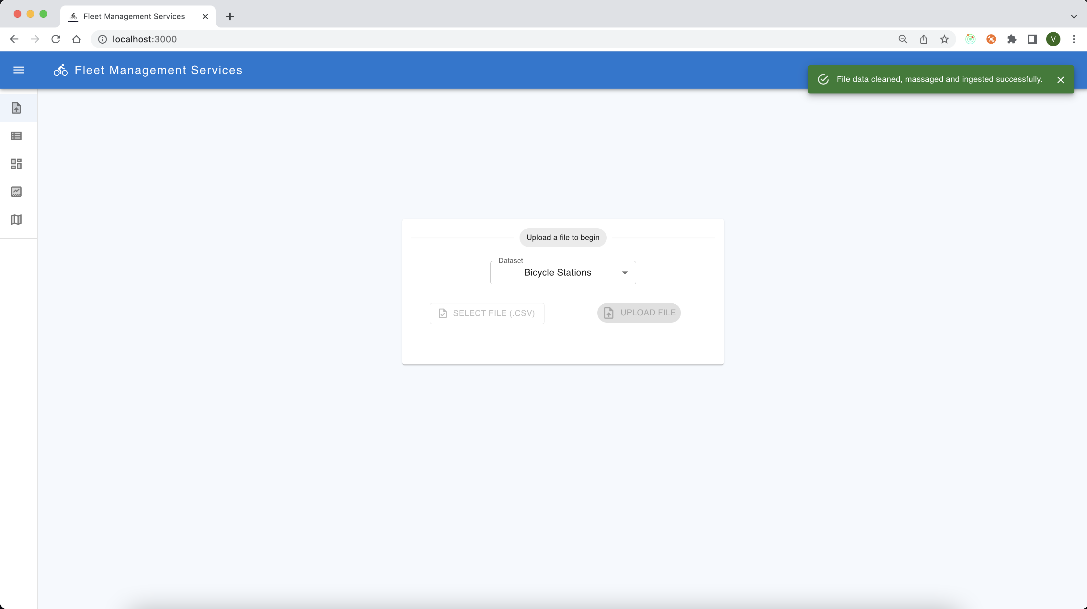
Upload File Screen 3/3

Slide 6
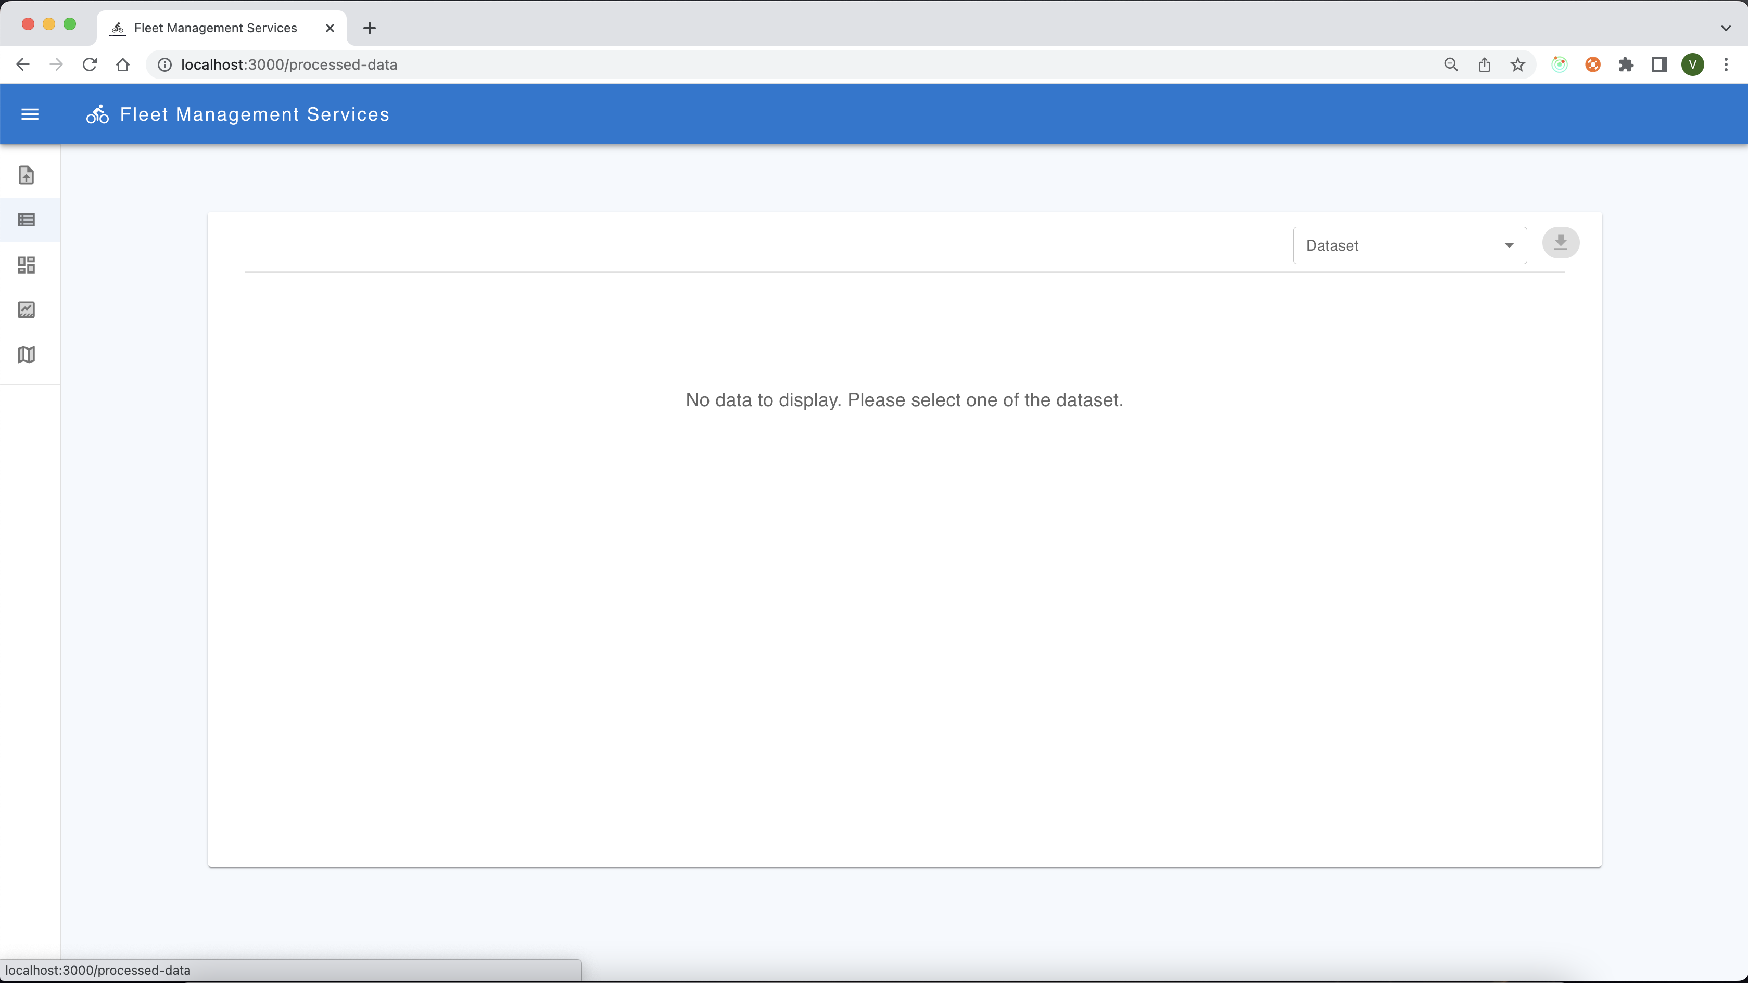
Processed Data View Screen 1/3

Slide 7
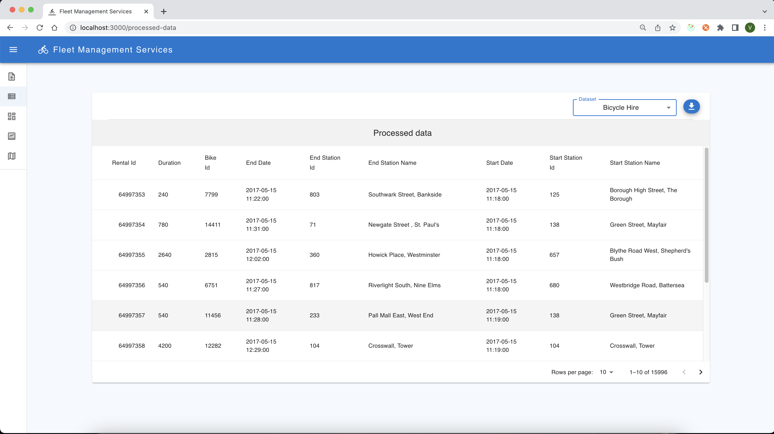
Processed Data View Screen 2/2

Slide 8
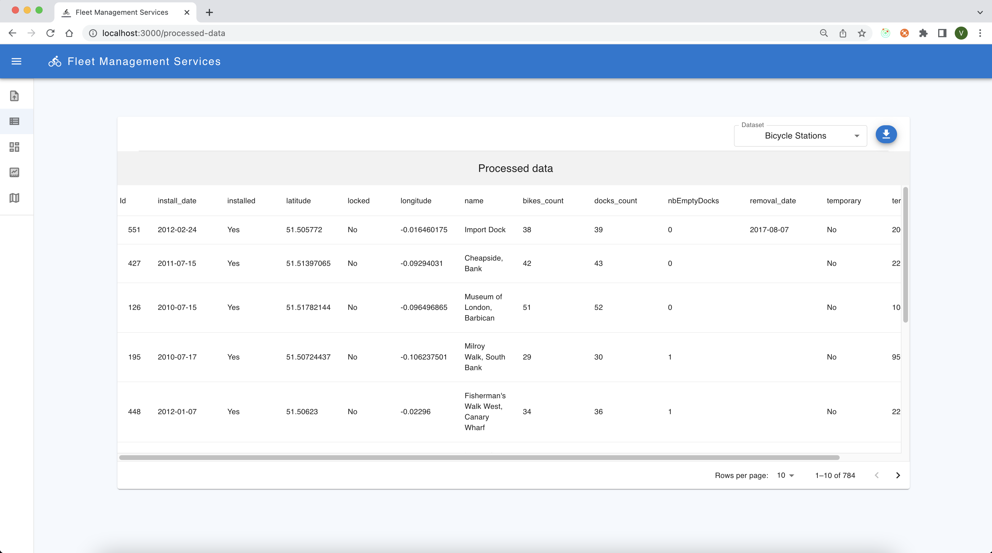
Processed Data View Screen 3/3

Slide 9
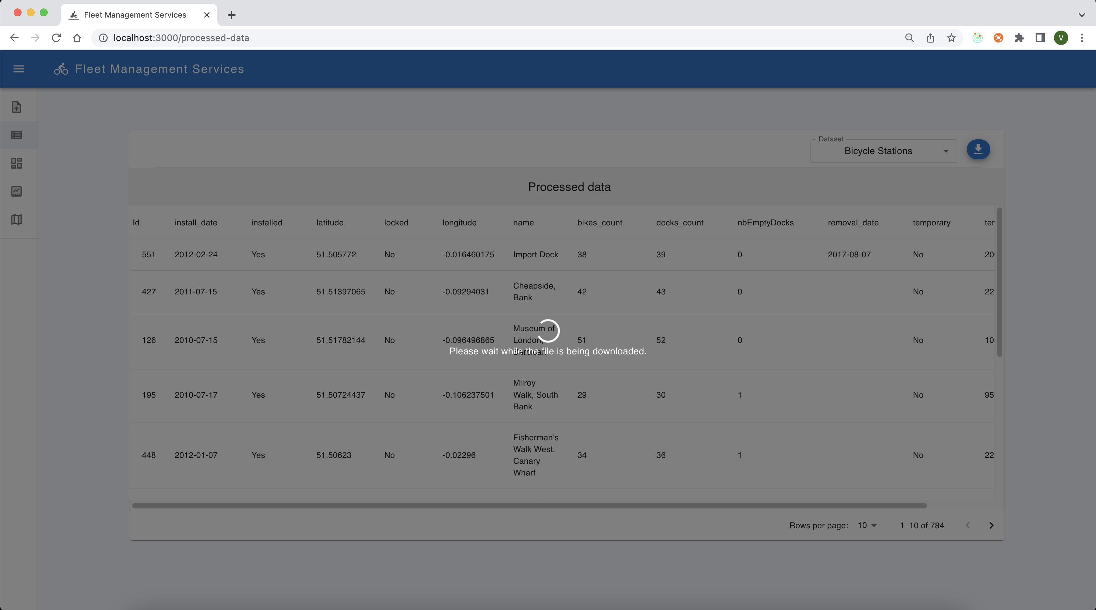
Download Processed data Section 1/2

Slide 10
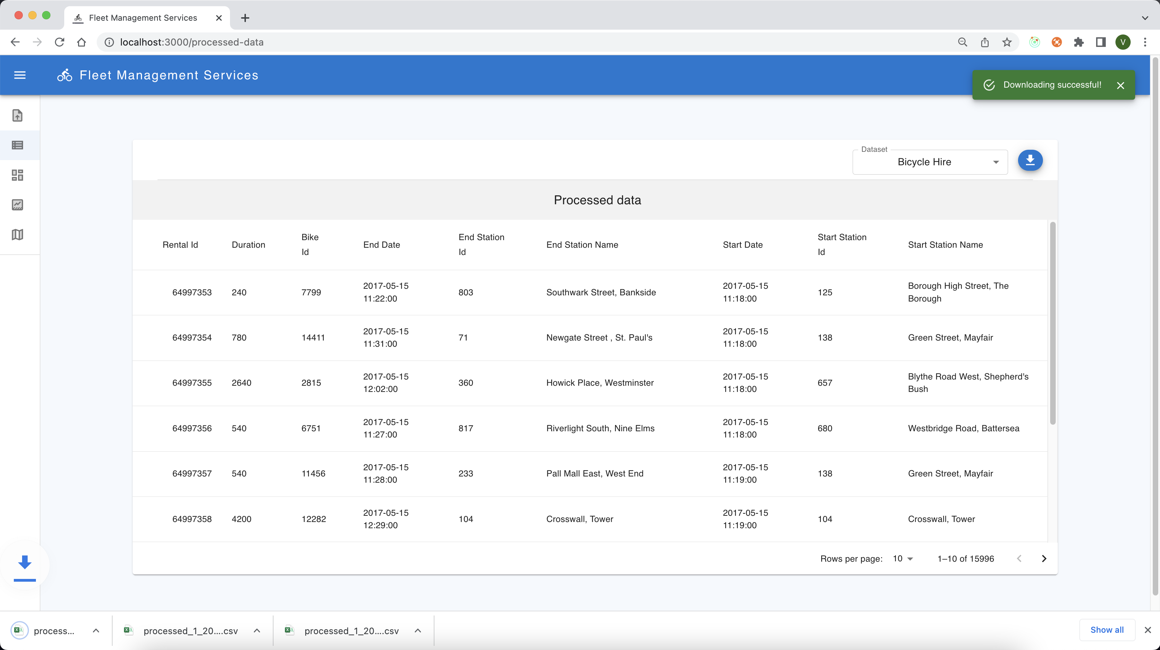
Download Processed data Section 2/2

Slide 11
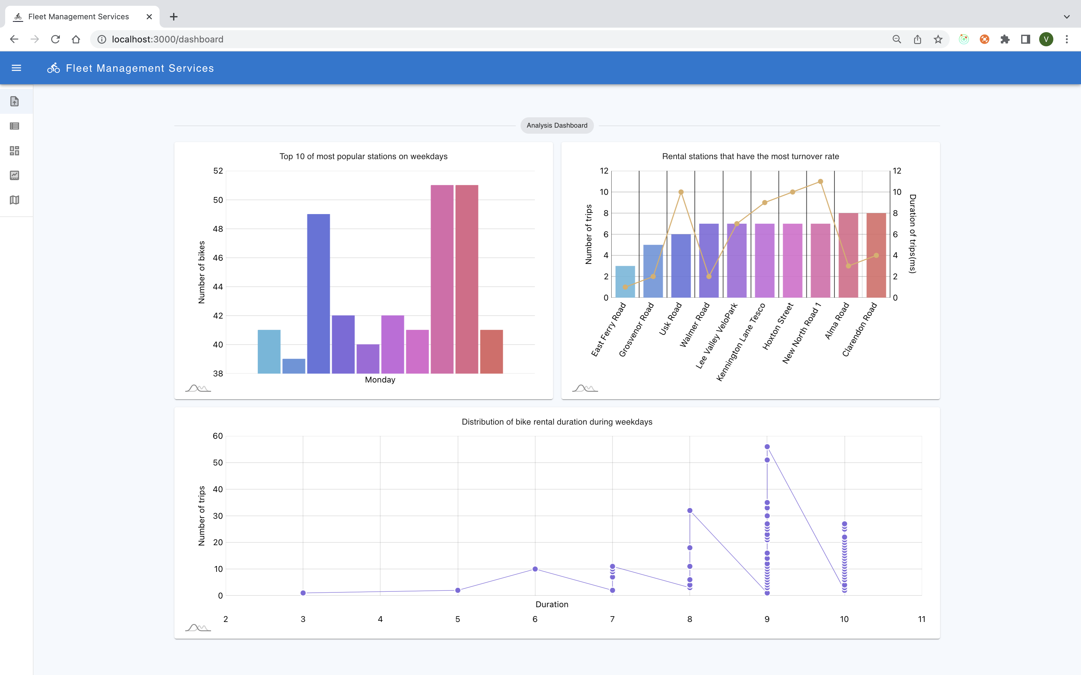
Analysis dashboard

Slide 12
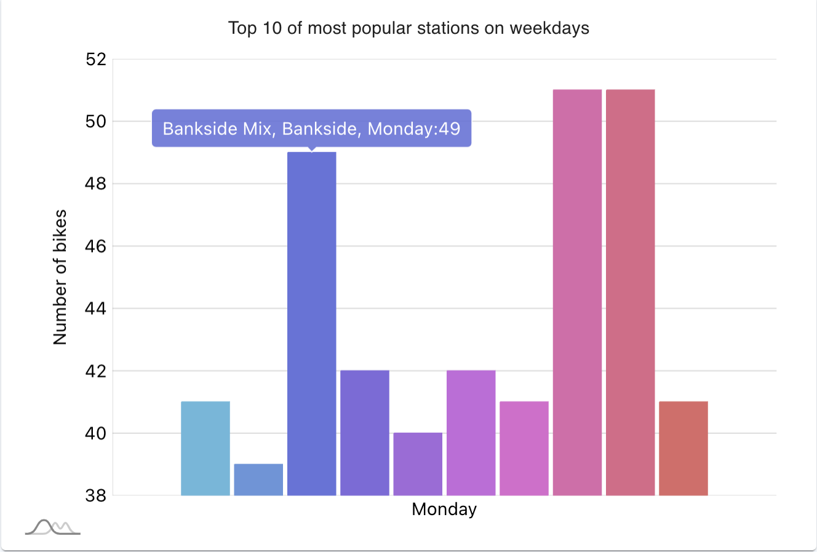
Top 10 MOst popular stations on weekdays

Slide 13
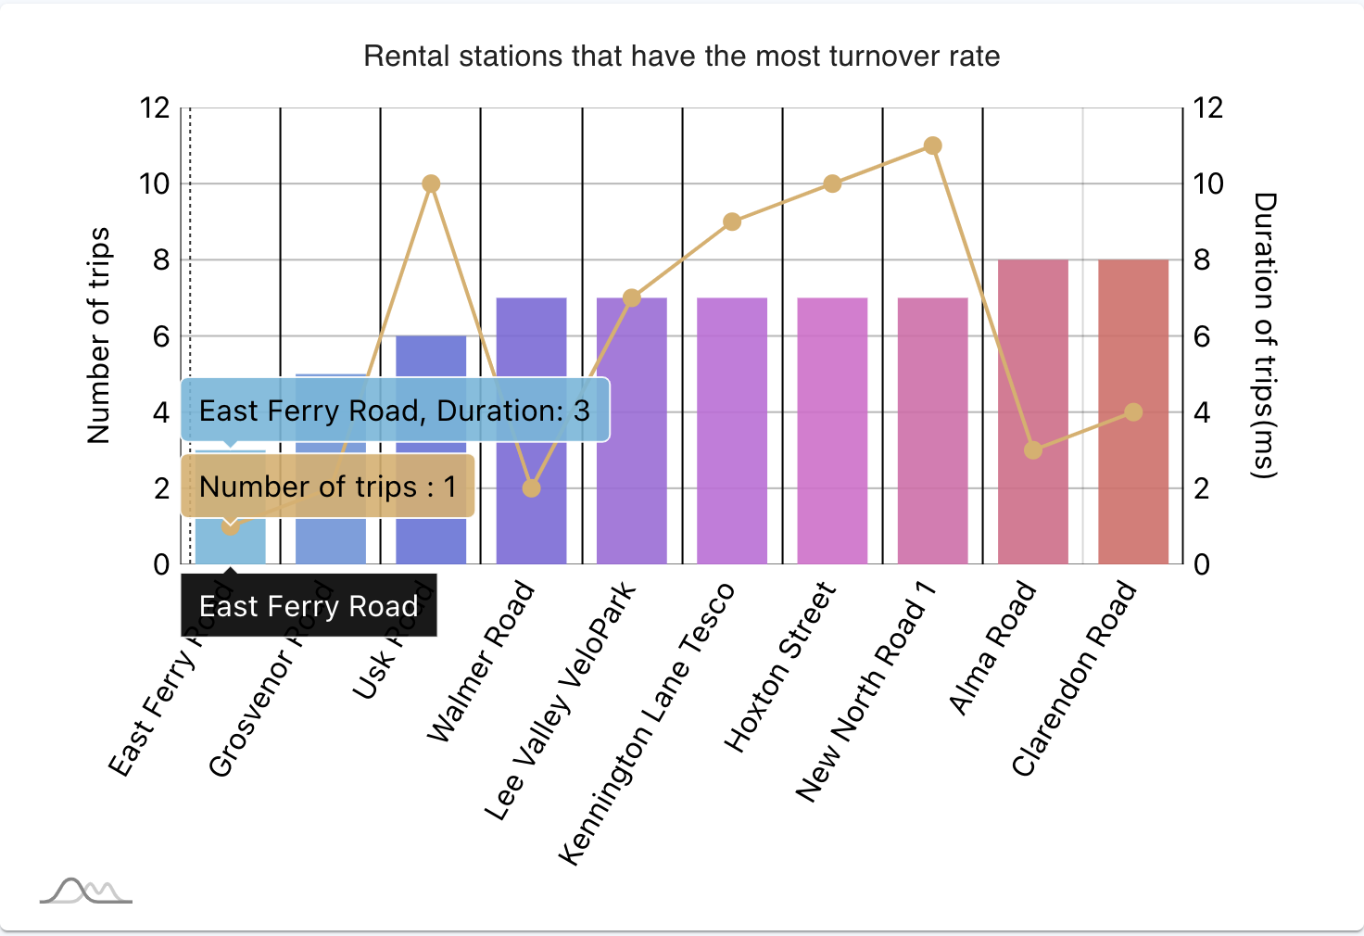
Rental stations that have the most turnover rate

Slide 14
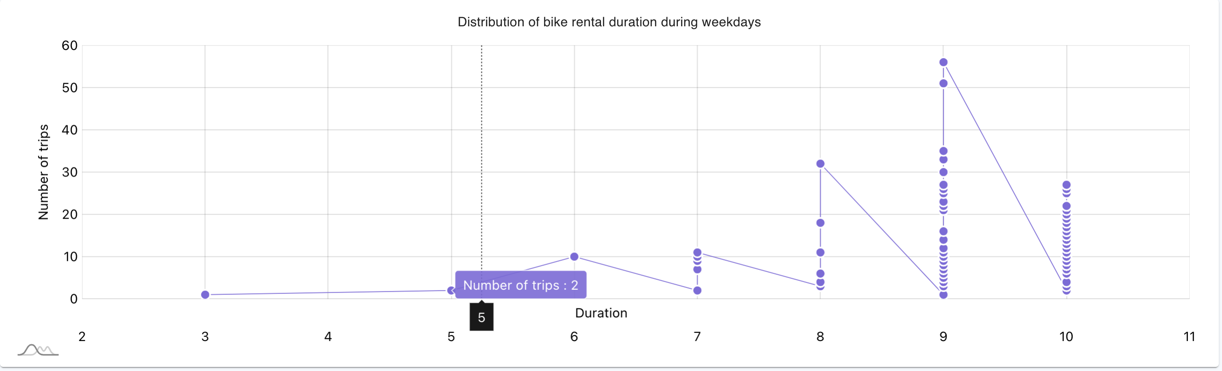
Distribution of bike rental duration during weekdays

Slide 15
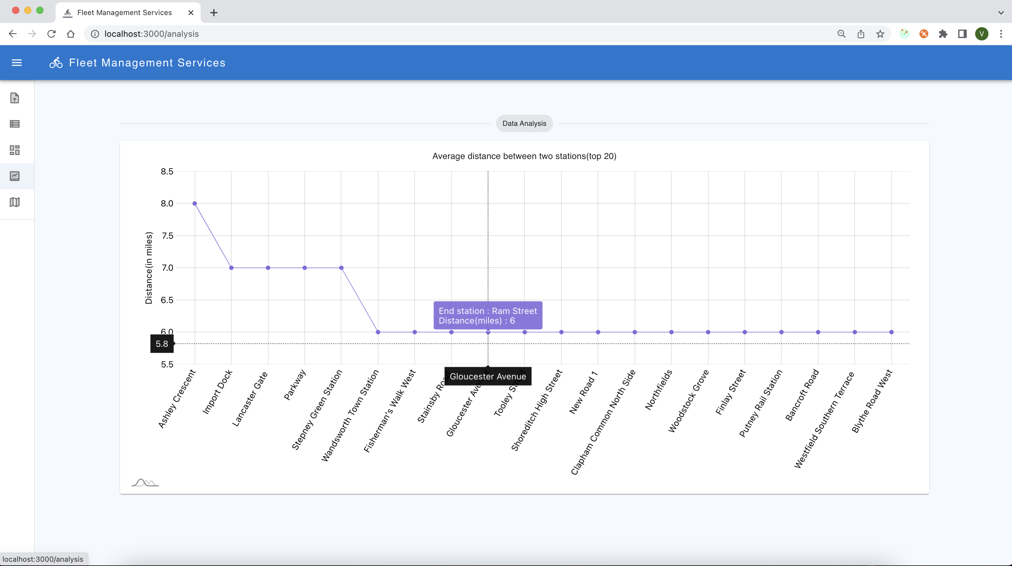
Data analysis screen Average distance between two stations(top 20)

Slide 16
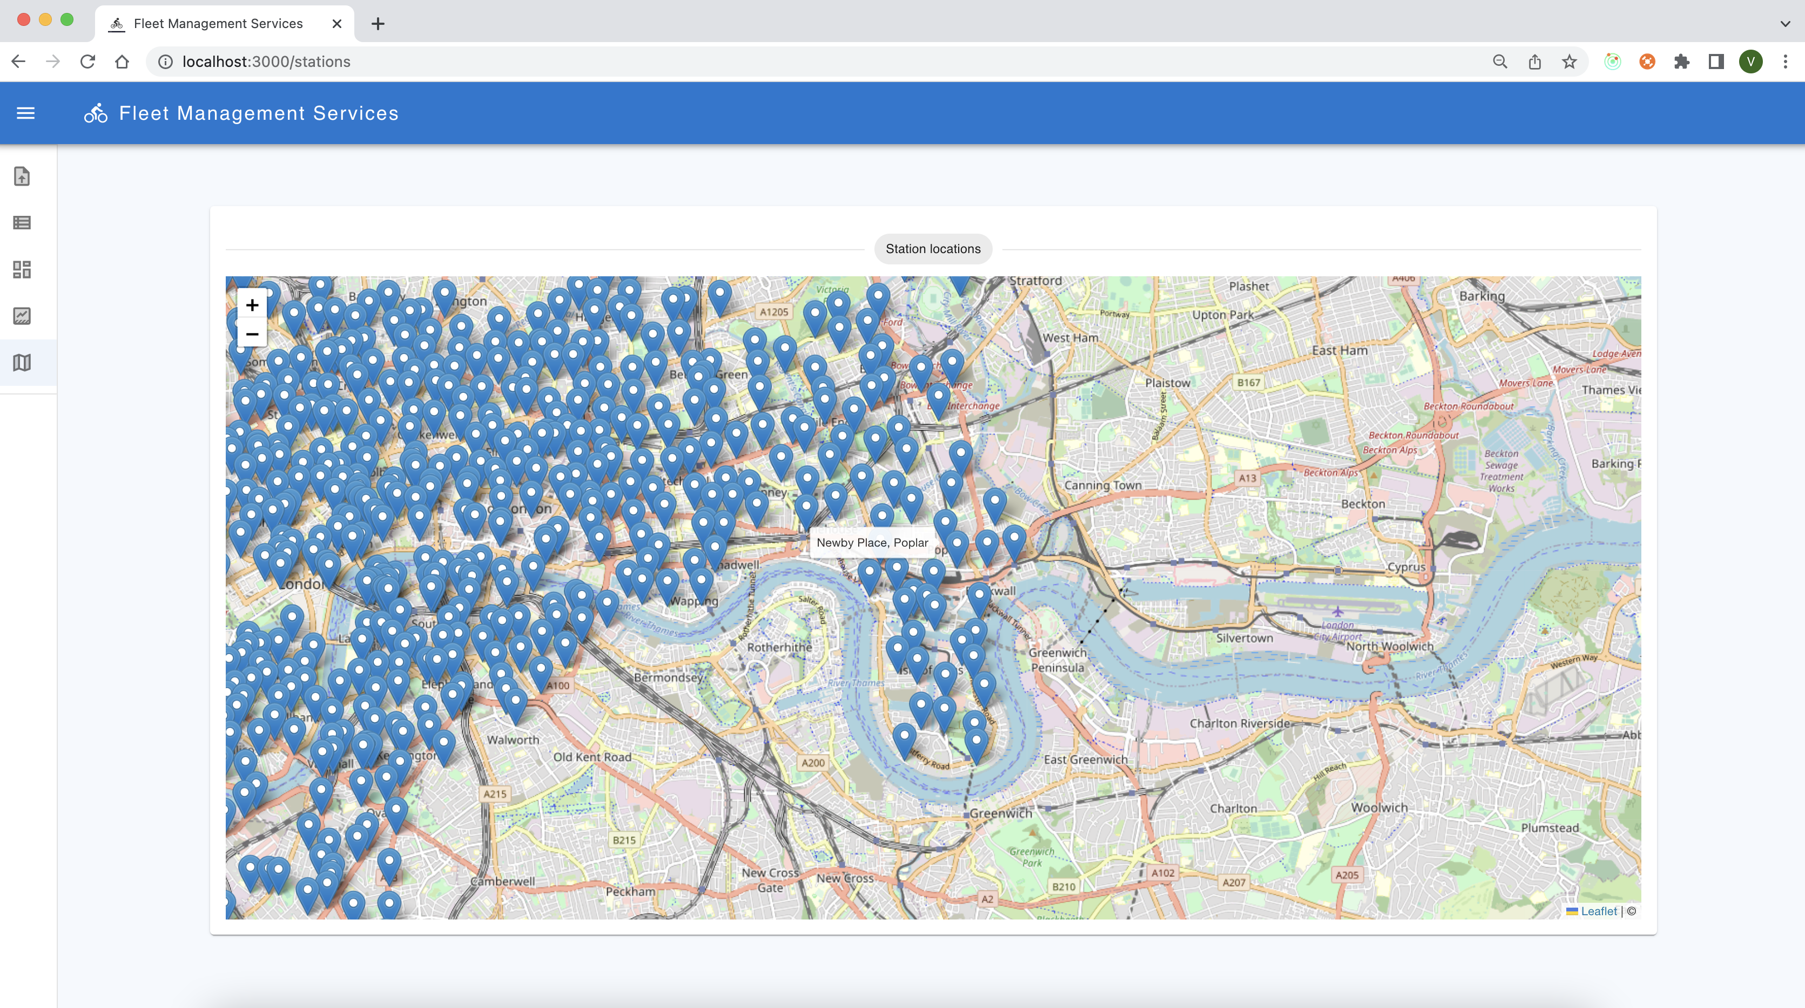
Stations location on map screen 1/2

Slide 17
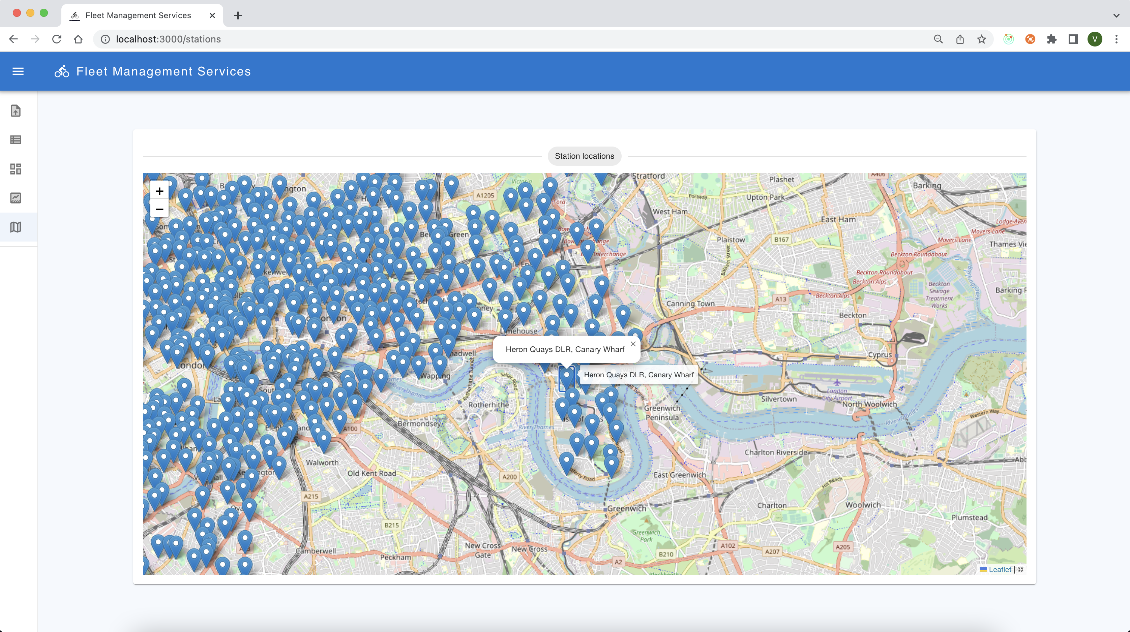
Stations location on map screen 2/2

Slide 18
TECH STACK
Frontend
MUI – for UI components
React
React-Redux – for state management
AMCharts – for charts implementation
React LeafLet – for map charts
Axios with Redux-Thunk – for APIs implementation and middleware
Backend
Python
Flask
Pandas
SQLAlchemy
Database
Postgres

